Slide 1
Micro Web Frameworks
Open Source + .NET

Slide 2
Definition
Lean - provides only the bare essentials for serving web applications on the web
Simple setup - getting web pages up and running should not require a lot of infrastructure code
Extensible API - enhanced features should be provided by other libraries that extend the framework
"Close to the metal"

Slide 3


Ruby micro web framework
$ gem install sinatra
$ ruby –rubygems app.rb
require 'sinatra'
require 'liquid'
get '/' do
liquid :index
end

Slide 4
Traditional web frameworks
Micro web frameworks
WebForms
ASP.NET MVC
FubuMVC
OpenRasta
Nancy
Jessica
Tinyweb
Nina
Martin
NSinatra

Slide 5

#jessicafx
Jessicafx.org
github.com/tombell/jessica

Slide 6
“Nancy has taken an approach to making many parts of the framework replaceable; if you don’t like the functionality of X you can create your own… I would like Jessica to become a feature equivalent of Sinatra for .NET, without heading in a similar direction that Nancy has taken. Jessica should have simple configuration, simple conventions, and simple code.” – Tom Bell

Slide 7
Setting up a project
Add Jessica assembly references
Create Global.asax and web.config
Create folders for modules, views, and assets
Create modules with routes and actions
Add views
Add assets

Slide 8
Setting up a project
Minimum web.config
<?xml version="1.0"?>
<configuration>
<system.web>
<compilation debug="true"/>
</system.web>
</configuration>

Slide 9
Setting up a project
Global.asax:
protected void Application_Start(object sender, EventArgs e)
{
Jess.Initialise();
}

Slide 10
Components
HttpHandler
Modules
Routes
Views
Response
View engines
Factory (IoC)

Slide 11
Modules
All modules inherit from JessModule.
Modules support standard HTTP methods:
JessModule.Get()
JessModule.Post()
JessModule.Put()
JessModule.Delete()

Slide 12
Routes
Routes are created in the module constructor and passed to instance methods that correspond to HTTP methods that the routes are going to handle.
Rotes are composed of:
a route pattern
an action

Slide 13
Route patterns
A Route pattern is used to match a URL to a route handler. Patterns may be:
a literal path: /shop/books
variable segments: /shop/books/:id

Slide 14
Route patterns
Root paths may also be used in Jessica, by passing the root path to the JessModule base constructor.
public class MyModule : JessModule {
public MyModule() : base("/home") {
//matches /home/faq
Get("/faq", p => View("faq"));
}
}

Slide 15
Route actions
Jessica routes receive dymanic objects which contain route parameters, and return a Jessica.Response object. Actions are typically lambda expressions defined when the route is added in the Module constructor.

Slide 16
Route anatomy
Get("/shop/books/:id",
p => View("books", p));
method
pattern
action

Slide 17
Route resolution
Jessica makes use of the default ASP.NET routing engine. When Jess.Initialise() is called in Global.asax, routes are added to the .NET RoutingTable class.

Slide 18
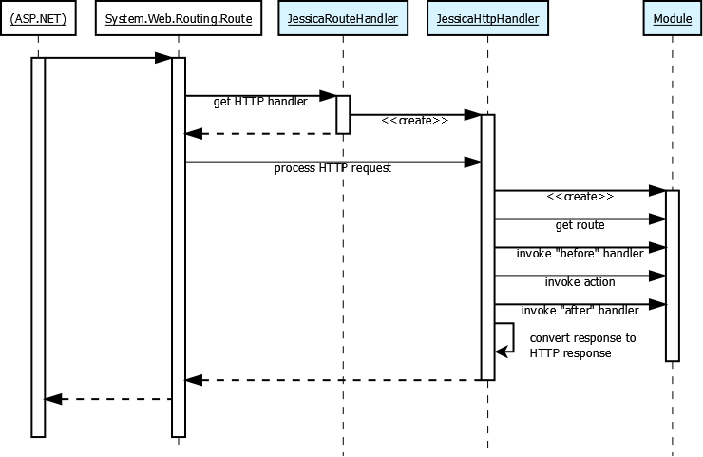

Slide 19
Serving up views
Views are flat files that may or may not be parsed by a view engine.
By convention, views must be placed in the ~/Views folder. Presently, this is not extensible, but that may change in the future.

Slide 20
Serving up views
View engines are selected dynamically, based on the view’s file extension. Views are resolved, however, with the base file name.

Slide 21
Serving up views
Currently, layout management (e.g., master pages) and partials are unsupported, because those features are implemented in the ASP.NET and MVC assemblies, respectively.
The exception to this is the Spark view engine, which uses its own content inclusion scheme.

Slide 22
View engines
View engines implement the IViewEngine interface, and may support one or more file extensions.
View engines are selected by the ViewFactory based on the file extension of the view being rendered.

Slide 23
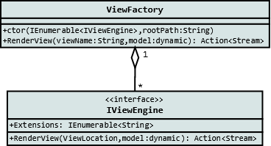

Slide 24
View engines
Custom view engines can be added by creating a class that implements IViewEngine.
Jessica has no “default” view engine implementation. To use a view engine, an appropriate view engine binary must be referenced.

Slide 25
View engines
Authored by Tom Bell
Razor
Spark
DotLiquid
Authored by me
Markdown
Textile

Slide 26
Response
The Jessica.Response object is responsible for aggregating headers, an HTTP status code, a content type, and an Action<Stream> delegate that returns rendered output to the HttpResponse object.
Route actions return a Jessica.Response object.

Slide 27
Response
Jessica has several standard responses:
TextResponse
RedirectResponse
FileResponse
JsonResponse
StaticFileResponse

Slide 28
Response
The Jessica.Response object has a number of helpful implicit cast operators:
Int32 (HTTP status code value)
String (contents)
Action<Stream> (response stream delegate)

Slide 29
Specialized responses
The Jessica.Response object provides specialized extension methods for returning content other than views.
AsFile()
AsJson<T>()
AsHtml()
AsText()
AsCss()
AsJs()
AsRedirect()

Slide 30
Specialized responses
These methods return specialized subclasses of the Jessica.Response object that are each responsible for locating, formatting, and setting response headers for the data that is streamed back to the client.

Slide 31
View models
All view models in Jessica are dynamic objects.
Strong types may also be used, but there is no special model binding provision for special cases at this time.

Slide 32
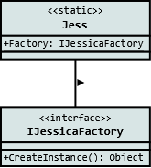
Factories (IoC)
Modules and view engines are created by a default implementation of IJessicaFactory.
This interface may be extended to implement a factory that uses any popular IoC container.

Slide 33
Factories (IoC)
There are presently two Factory IoC implementations available for Jessica:
Ninject
StructureMap

Slide 34
Factories (IoC)
To change the factory that Jessica uses to resolve types, simply assign a new instance of a custom factory to Jess.Factory before calling Initialise() in Global.asax.
Jess.Factory = new MyCustomFactory();
Jess.Initialise();

Slide 35
<<code>>

